Slide 1
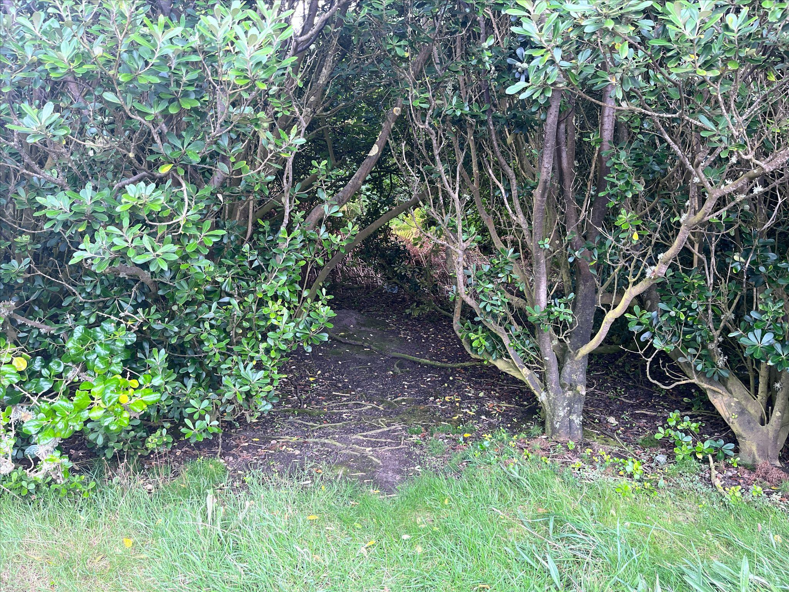
Minding the Gap
Exploring imaginal realms and the poetic image in the alchemical process of writing trauma

Slide 2
or…
Some of the things I thought about while writing, weaving and painting a life narrative during a very strange and intense three months

Slide 3
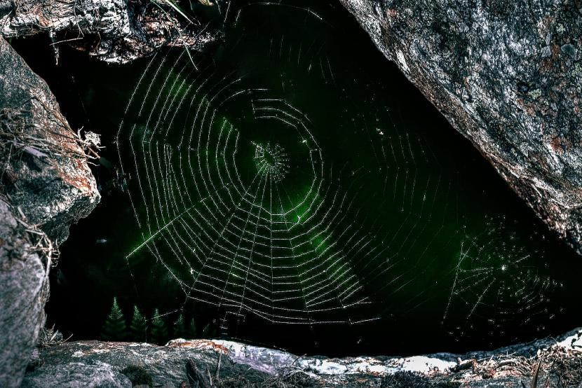

Slide 4
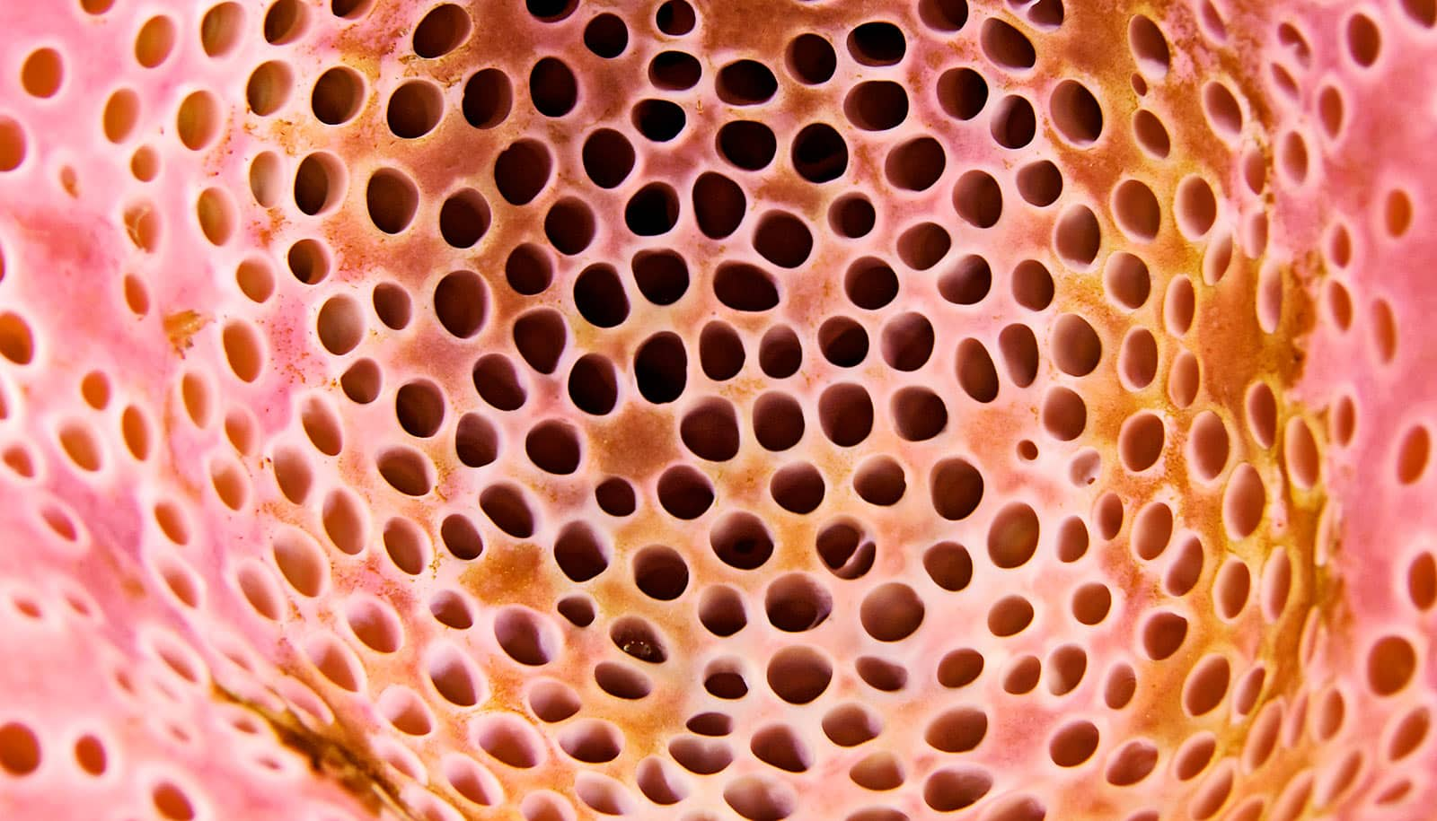

Slide 5
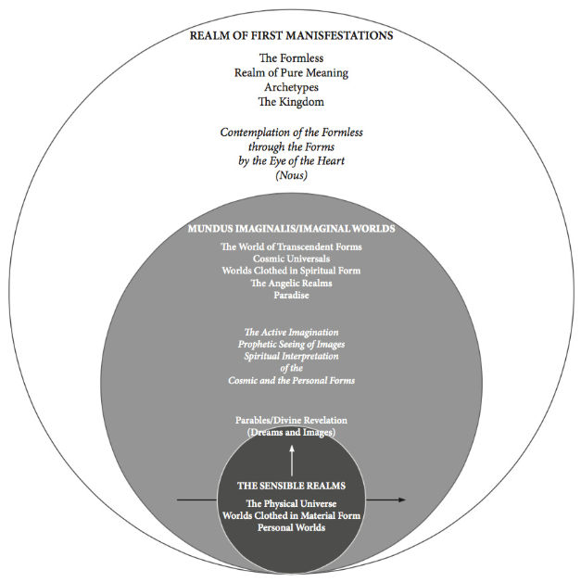
Cynthia Bourgeault

Slide 6
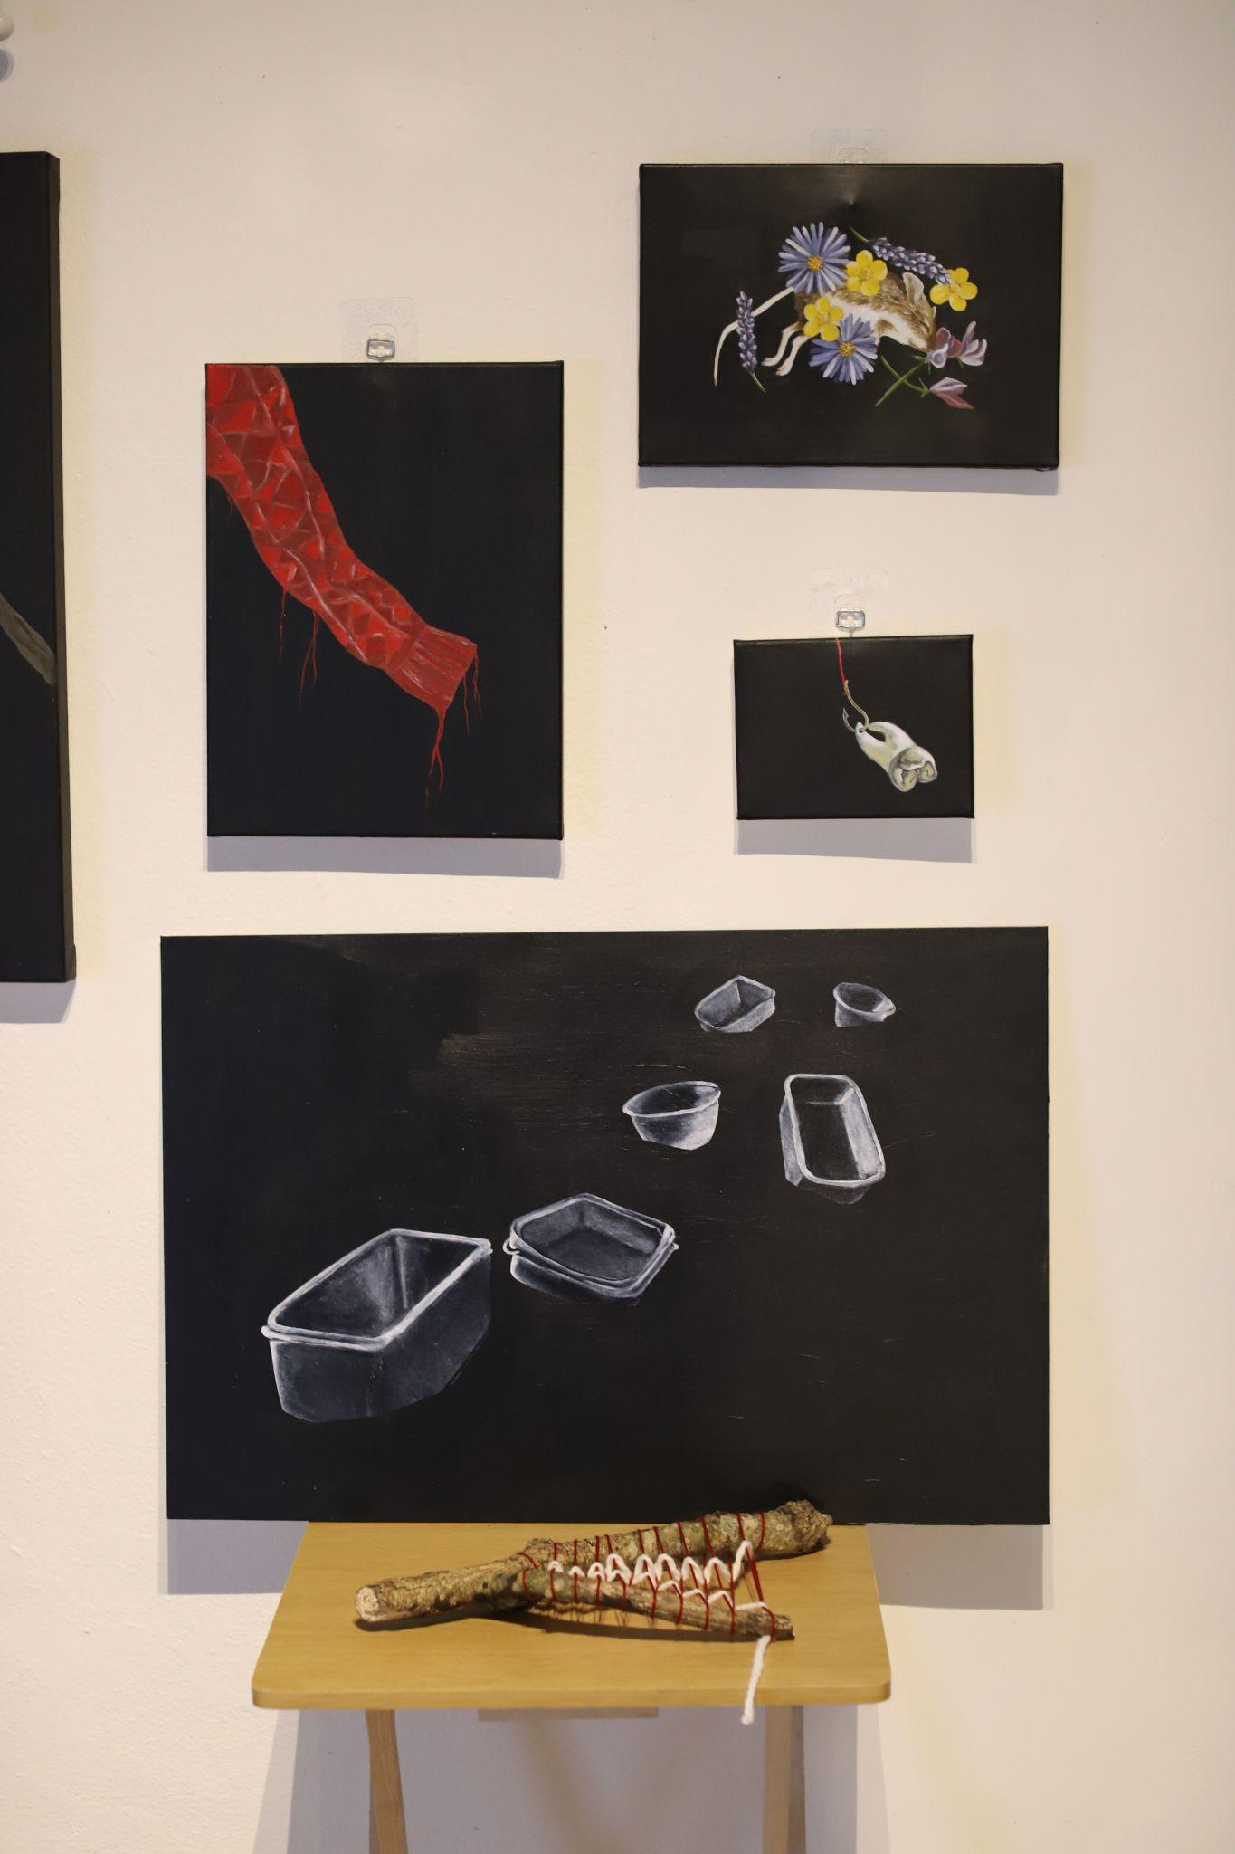
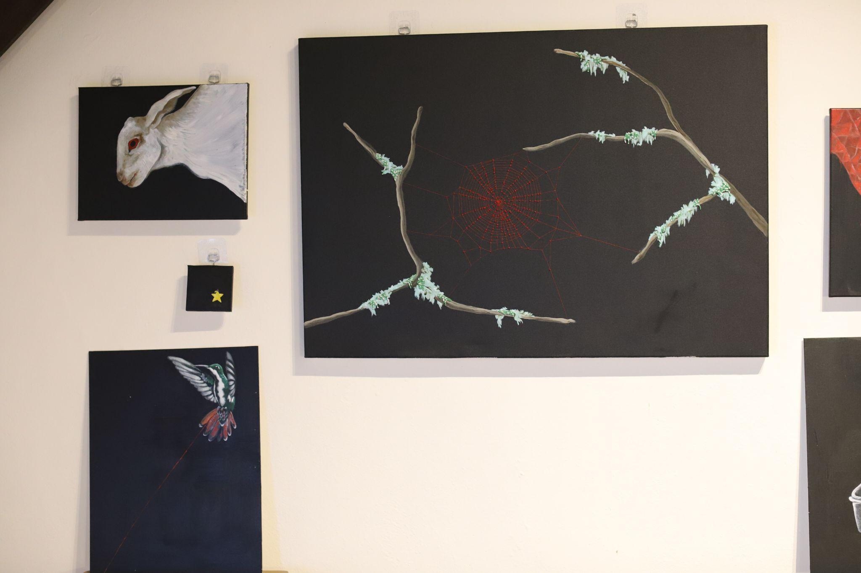

Slide 7
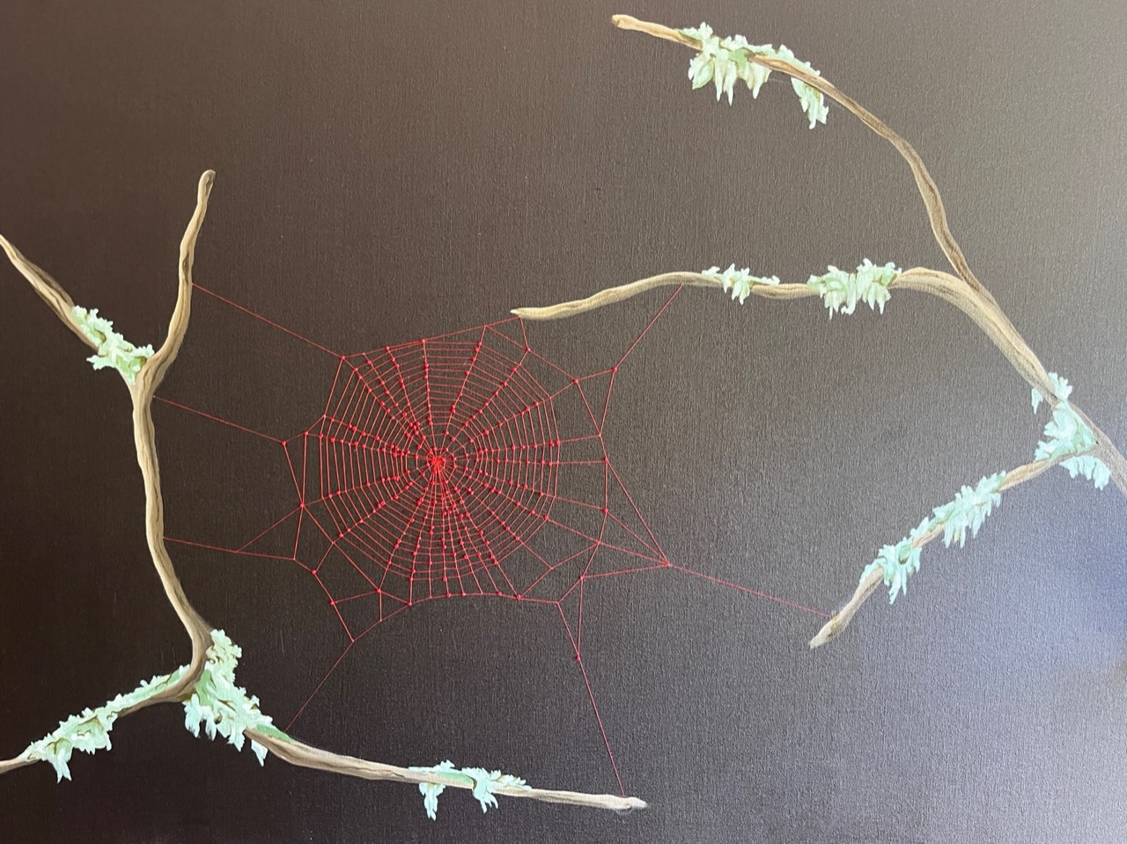

Slide 8
We create as ‘real’ the figures of the imagination, those beings with whom we sleep and walk and talk, the angels and the daimones… It is that mode by which the images, which we believe we make up, are actually presented to us as not of our making, as genuinely created, as authentic creatures.
James Hillman: The Thought of the Heart and the Soul of the World, p.10

Slide 9
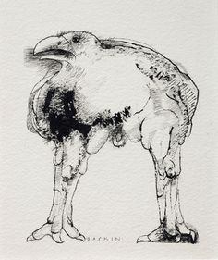
To hatch a crow, a black rainbow
Bent in emptiness
over emptiness
But flying.

Slide 10
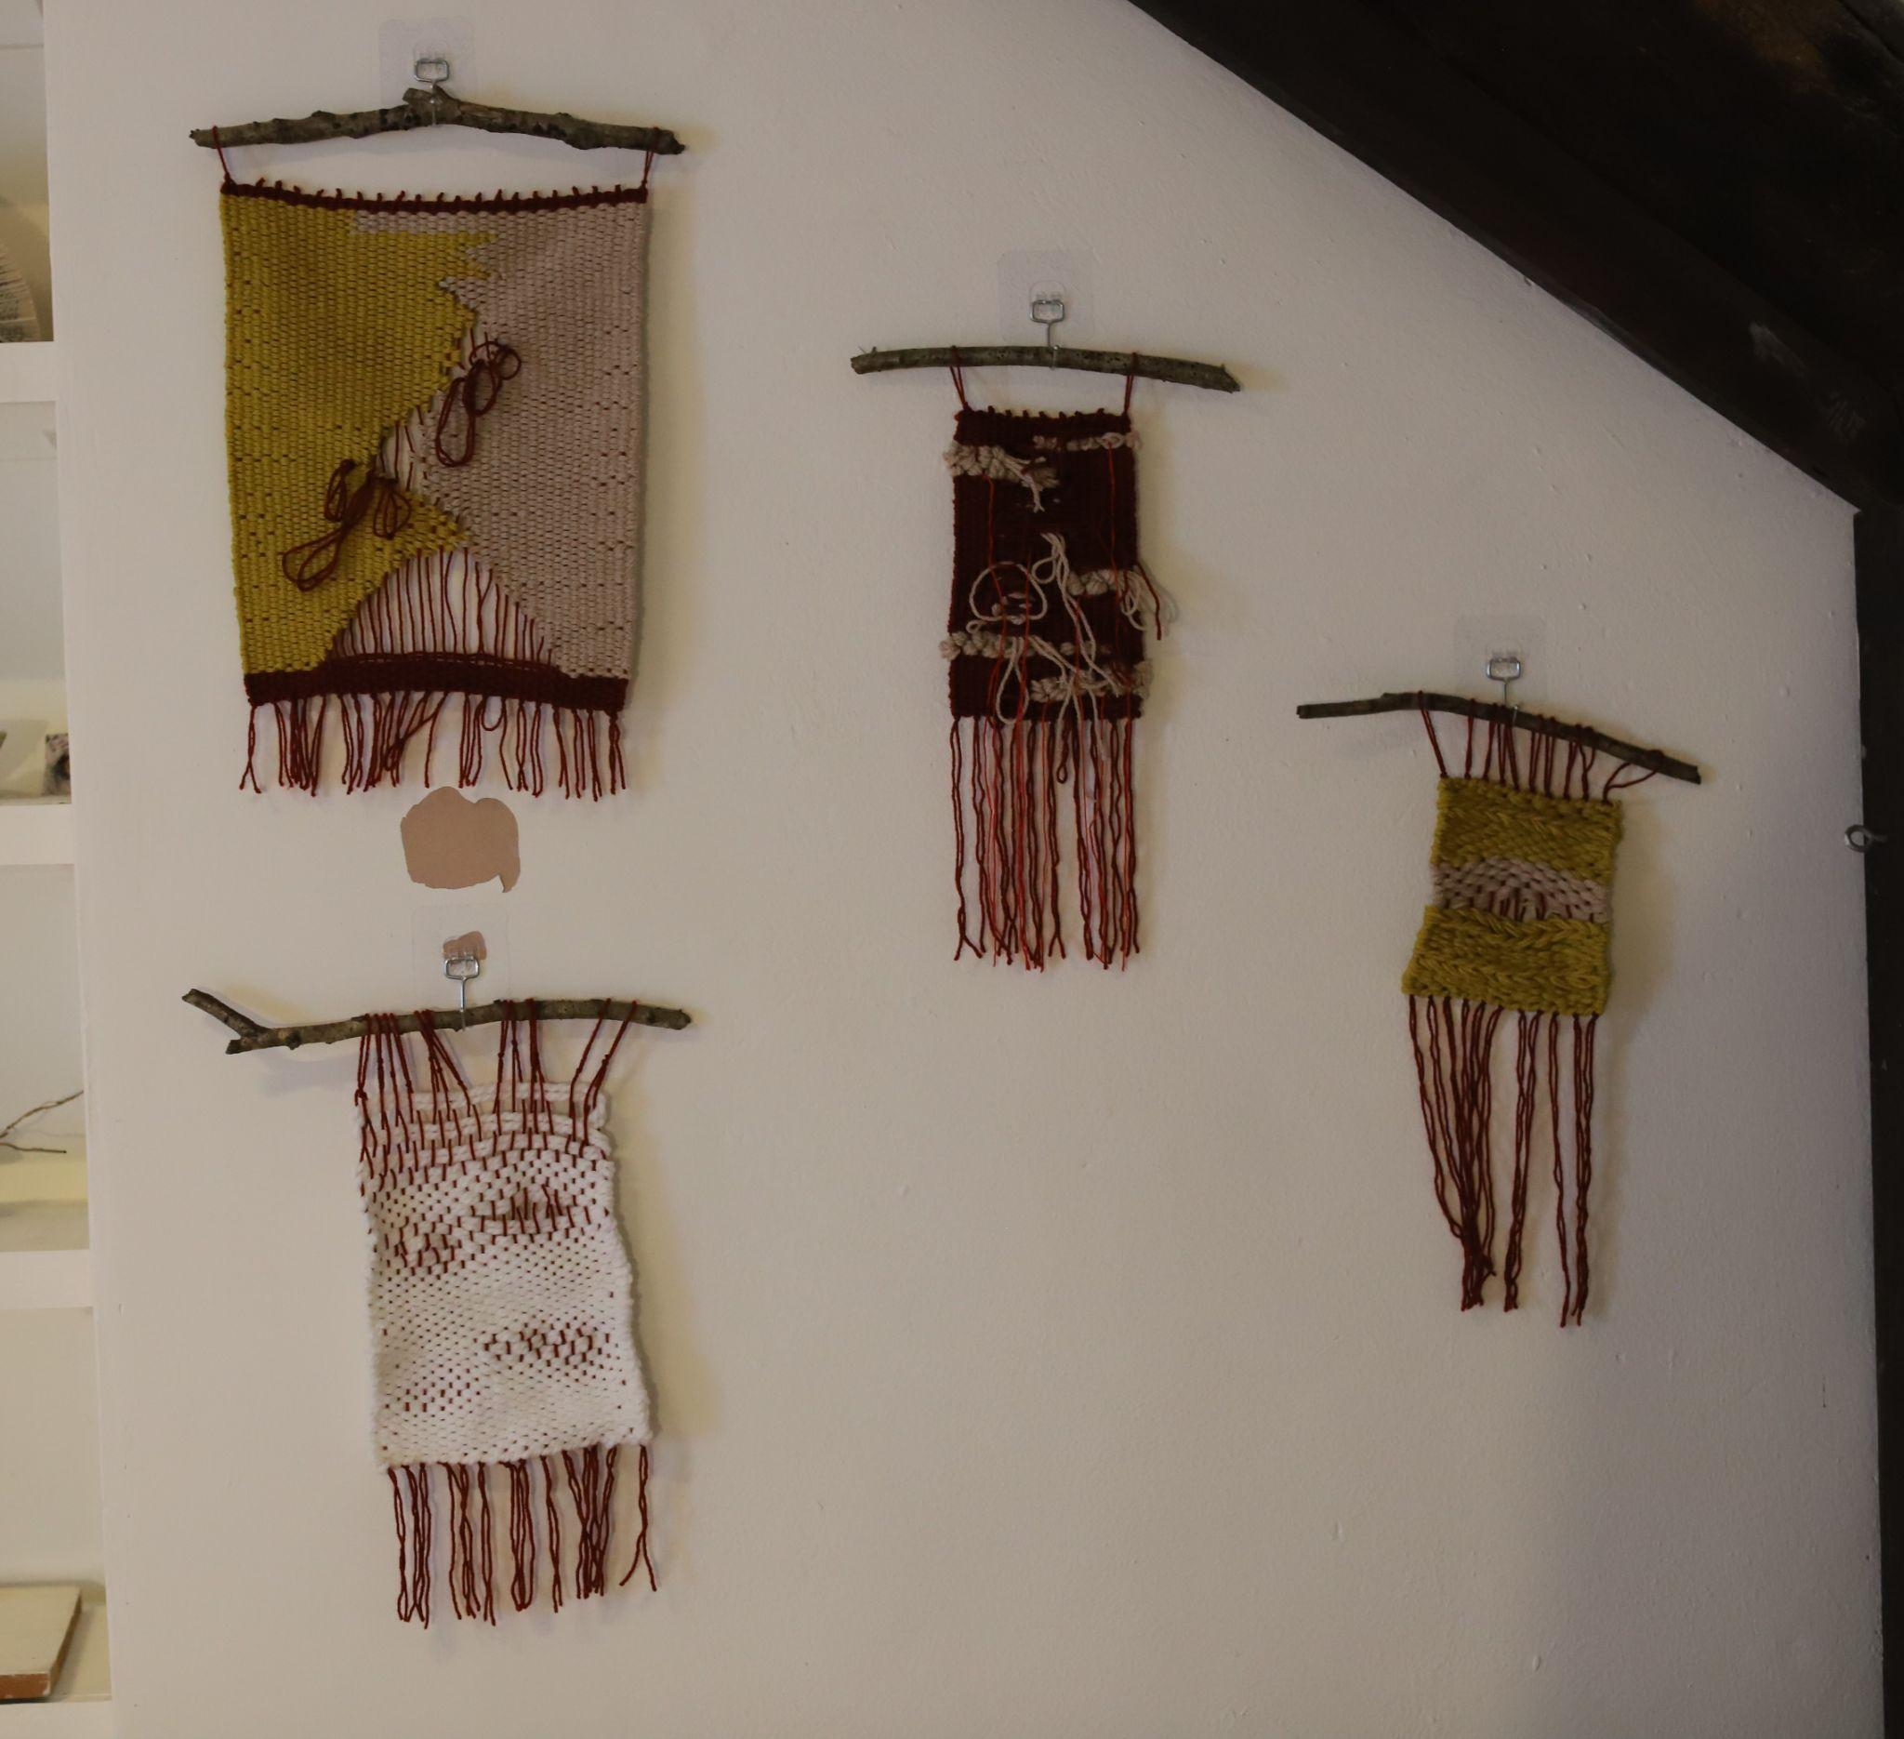
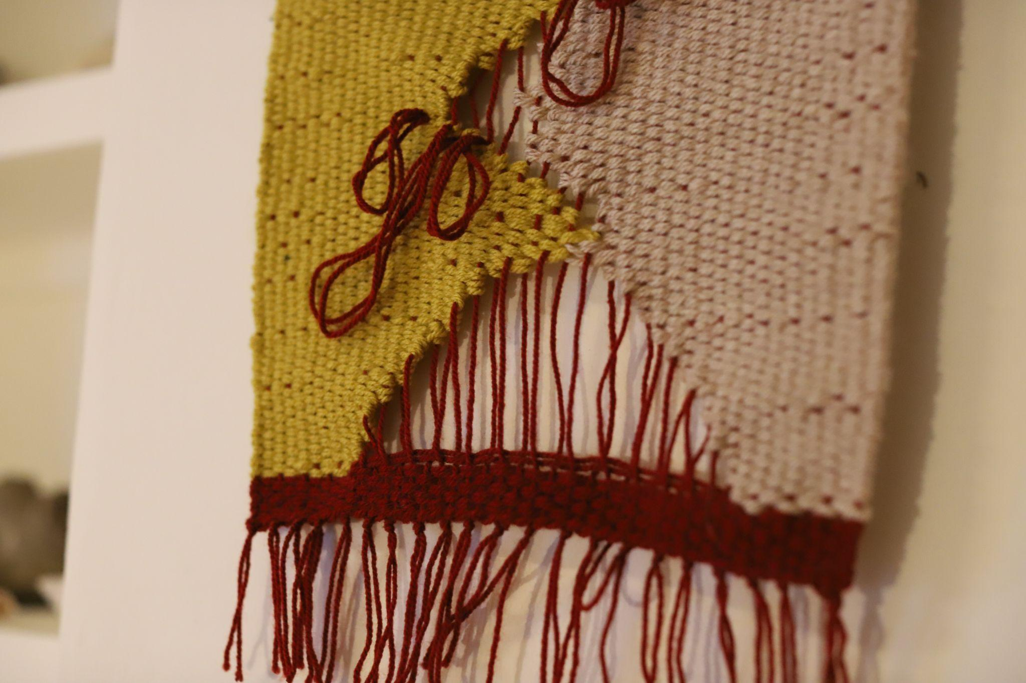

Slide 11
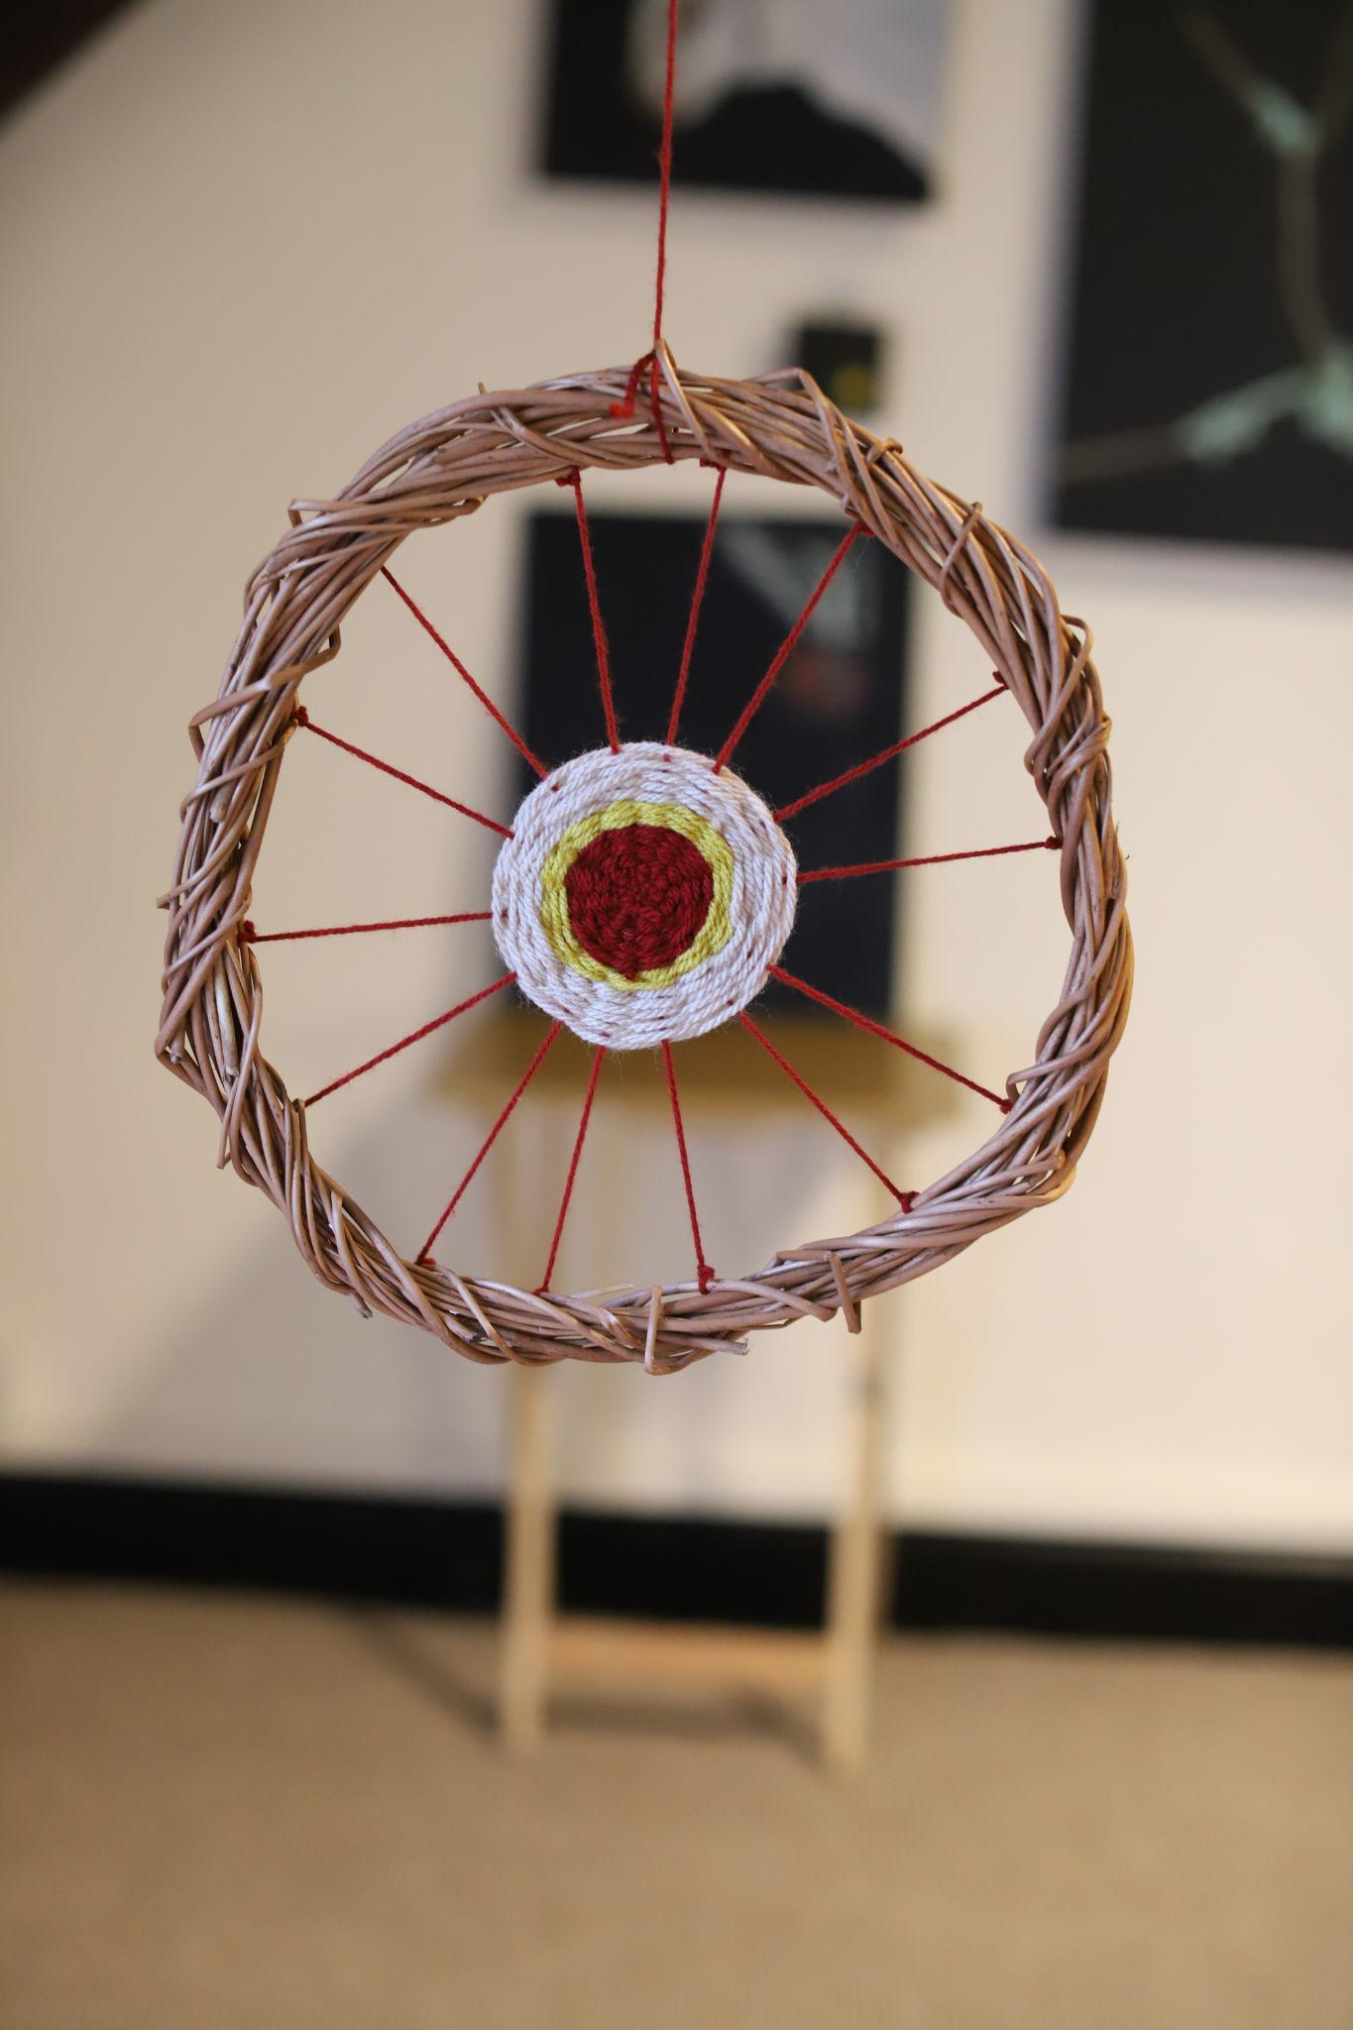
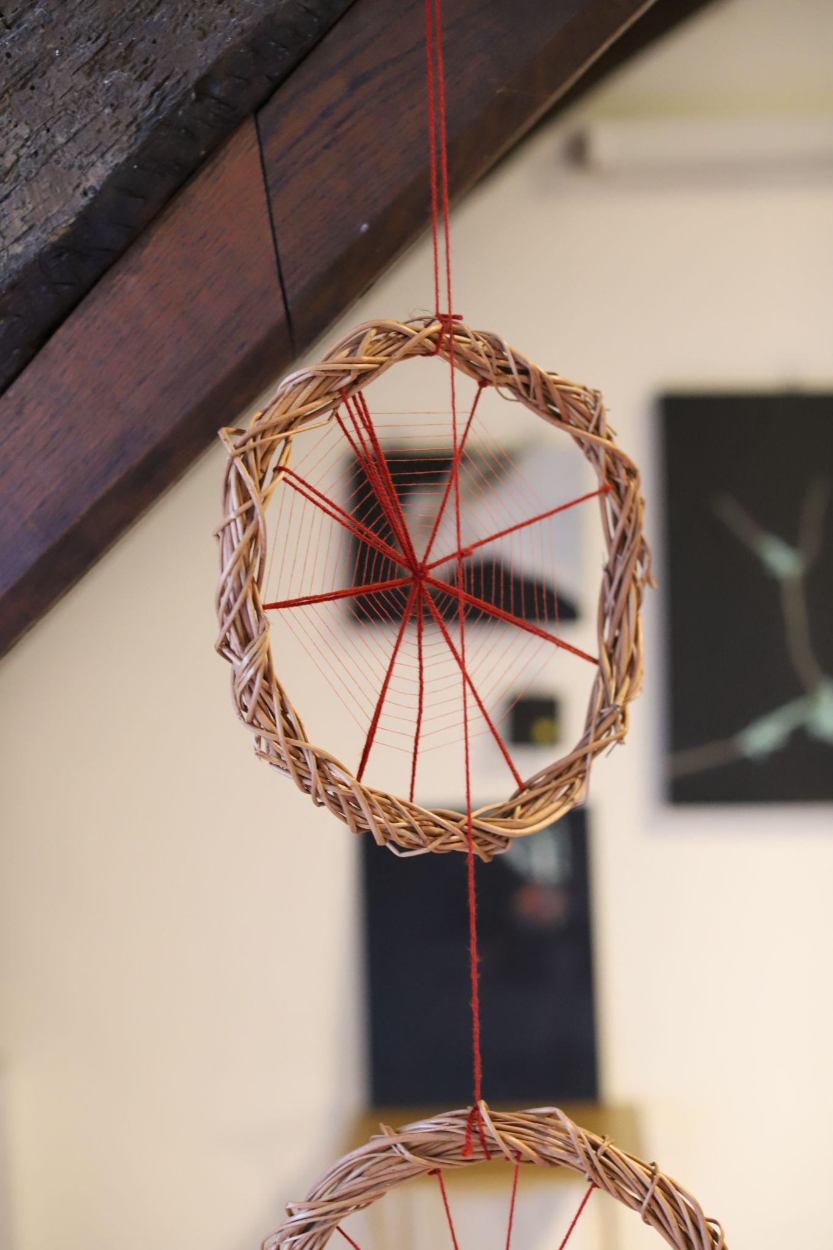

Slide 12
References
Abrams, D. (1997). The Spell of the Sensuous: Perception and Language in a More-Than-Human World. New York: Vintage Books, pp. 37-38.
Alaimo, S. (2010). Bodily Natures: Science, Environment, and the Material Self. Bloomington: Indiana University Press.
Bachelard, G. (2014). The Poetics of Space. London: Penguin Classics, pp. 8-242.
Blackie, S. (2019). If Women Rose Rooted: A Life-changing Journey to Authenticity and Belonging. Tewkesbury, Gloucestershire: September Publishing.
Chittick, W. (1989). The World of Imagination and Poetic Imagery According to Ibn al-’Arābī. Temenos 10, pp. 99-119.
Cleghorn, E. (2021). Unwell Women: Misdiagnosis and Myth in a Man-made World. New York: Dutton.
Gordon A. (2008). Ghostly Matters: Haunting and the Sociological Imagination. Minneapolis: University Minneapolis Press.
Haraway, D.J. (1991). Simians, Cyborgs, and Women : The Reinvention of Nature. New York: Routledge, pp.149–181.
Hillman, J. (2014). The Thought of the Heart and the Soul of the World. Putnam: Spring Publications, Inc, pp. 10-58.
Hyde, L. (2017). Trickster Makes This World: How Disruptive Imagination Creates Culture. Edinburgh: Canongate Books.
Kane, S. (1998). Wisdom of the Mythtellers. Ontario: Broadview Press.
Marder, E. (1992). Disarticulated Voices: Feminism and Philomela. Hypatia 7:2. Pp. 148-166.
Maté, D. and Maté, G. (2023). The Myth of Normal: Trauma, Illness and Healing in a Toxic Culture. Toronto: Vintage Canada.
Neimanis, A. (2017). Bodies of Water: Posthumanist Feminist Phenomenology. London: Bloomsbury Publishing.
Strand, S. (2024). The Body is an Ecotone. [online] Make Me Good Soil. Available at: https://sophiestrand.substack.com/p/the-body-is-an-ecotone-8dd [Accessed 10 Jul. 2024].
Van der Kolk, B. (2014). The Body Keeps the Score: Brain, Mind, and Body in the Healing of Trauma. London: Penguin Books.
https://ellierobins.substack.com/p/gleanings-so-far-from-a-life-devoted
https://www.cynthiabourgeault.org/blog/2018/11/13/introducing-the-imagina

